Slide 1
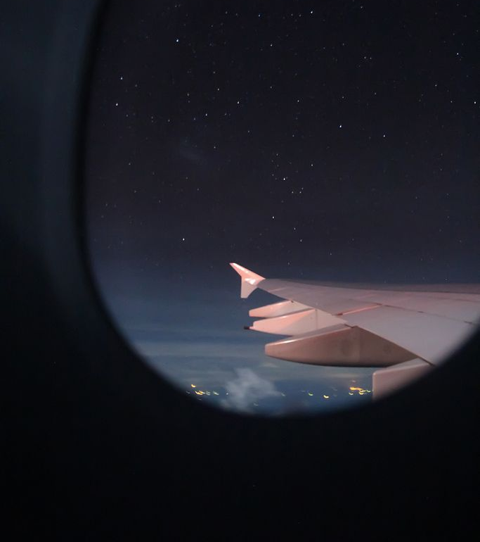

ux/UI dESIGN
Navigating the User Experience: A Quest for Enhancement and Evaluation

Slide 2
Summary
Introduction
User Research & Persona
Hook Canvas
Evaluation, comparison and psychology
Information architecture (Sketching and prototype)
Results
Summary and Recommendations

Slide 3
Introduction
Welcome to our project dedicated to transforming the user experience and user interface of our airline app. In today's fast-paced world, travel apps play a crucial role in the way people explore, book, and enjoy their journeys. In this project, we're focused on making the airline app an intuitive, visually appealing, and efficient tool for travelers.
Our mission is to streamline the user's journey from flight search to boarding and beyond. We'll be diving into the key principles of user-centered design to create an app that's not just functional, but truly delightful to use. Join us as we take off on a journey to enhance the airline app's UX and UI, making it a must-have tool for all travel enthusiasts.

Slide 4
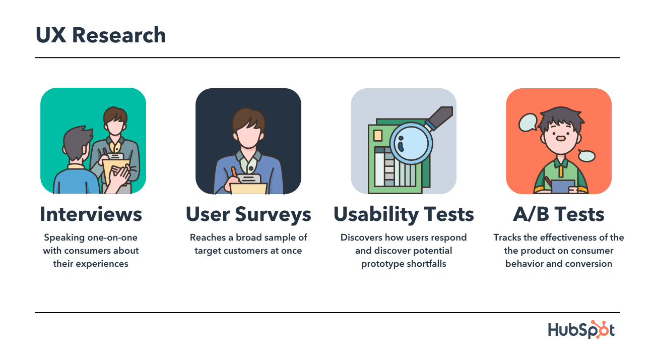
User research
Survey: We conducted a survey involving 12 individuals who regularly use the Royal Air Maroc app. The survey included questions related to age, gender, primary language, travel habits, booking preferences, and challenges encountered while using the app. Participants were also encouraged to provide personal feedback on their experience with the app.
Client Reviews: In addition to the survey, we analyzed client reviews of the Royal Air Maroc app from google play. These reviews provided valuable insights into common issues and pain points experienced by users.

Slide 5

Persona: Business profile
Scenario:
Ahmed Benjalloun
“My manager just called with an urgent request. I need to be in Paris for a Monday morning meeting. Luckily, I have my airline app. I quickly booked a morning flight on Sunday and chose an aisle seat. The app made the payment process seamless, and I received a confirmation instantly. It keeps me updated on flight details and even offers a mobile boarding pass. With the app's help, I breeze through the airport and stay productive during the flight. It's a lifesaver for last-minute trips like this one.”
Background
Goal
Age: 40
- Occupation: Business Executive
- Annual Income: $150,000+
- Education: MBA
- Technological Proficiency: Advanced computer and smartphone skills
- Ahmed, a frequent business traveler, prioritizes efficiency and seamless experiences. He relies on mobile apps for travel organization and values punctuality. He enjoys amenities like airport lounges and business class upgrades.
User environment
- Location: Office Casablanca
- Device: laptop, smartphone
Challenges
Balancing work and travel arrangements, such as flights, accommodations, and transportation.
Managing expenses within company travel policy while ensuring comfort.
Tracking loyalty programs, miles, and rewards across airlines.
Handling last-minute changes, delays, and cancellations.
Staying connected and productive with reliable Wi-Fi and business amenities.

Slide 6

Persona: Regular uSER
Marwa Kareem
Background
Goal
Age: 26
- Occupation: freelancer
- Annual Income: $10,000
- Education: MBA
- Technological Proficiency: Advanced computer and smartphone skills
I use travel booking platforms to book smooth , comfortable , affordable flight and seek for more diversity and enhanced options
Challenges
Flight delays
Management
Additional hidden fees
User environment
- Location: remote
- Device: laptop, smartphone,app
Scenario:
travel twice a year to explore European countries during holiday breaks, making new friends and embracing different cultures. Whether with friends or solo, I work remotely as a freelancer, relying on my laptop and travel apps to book affordable trips with good reviews.

Slide 7
Hook CanvaS
Trigger
External Prompts: Flight notifications, special offers, and personalized recommendations via push notifications stimulate user activity.
Internal Inspiration: Captivating visuals and travel stories generate internal motivation to engage with the app.
Action
Booking Streamlining: Simplifying the booking process for easy and efficient reservations.
User-Friendly Interface: Ensuring a straightforward app interface for a smooth booking experience.

Slide 8
Hook CanvaS
Social Rewards: Encourage users to share their travel experiences on social media, gaining recognition from peers.
Material Rewards: Provide discounts, loyalty benefits, and tailored offers based on user preferences.
Intrinsic Rewards: Offer satisfaction through personalized itineraries and exploring new destinations.
Investment in the airline app:
Time Investment: Users save preferences, create wish lists, and bookmark favorites, developing a sense of ownership.
Effort Investment: Advanced features like pre-fill options and personalized trip planning for one-click booking.
Emotional Investment: Create a user profile for sharing travel stories, fostering an emotional connection with the app.

Slide 9

“Competitive Analysis”

Slide 10
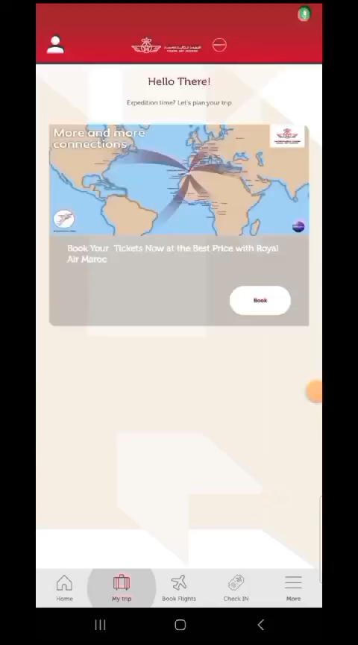
Competitive Analysis

Slide 11
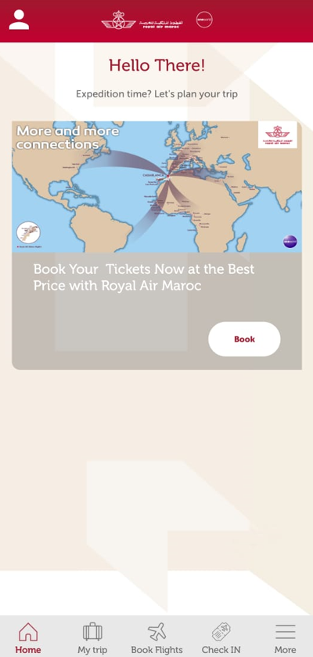
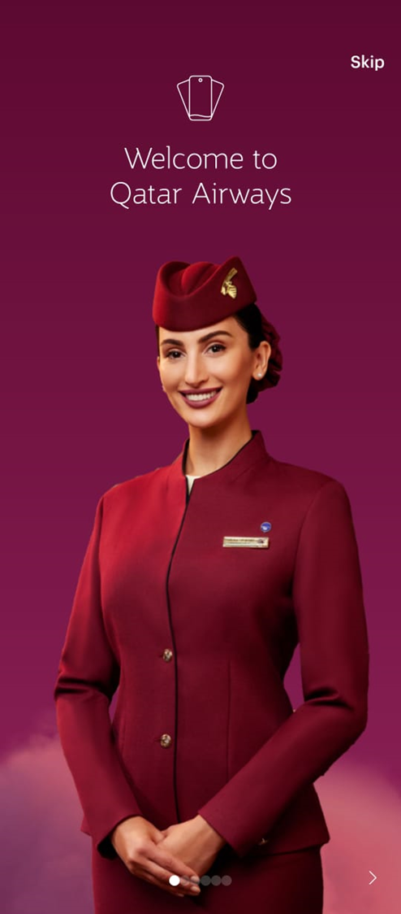
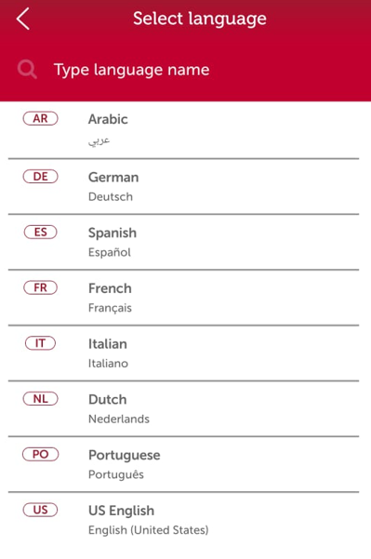
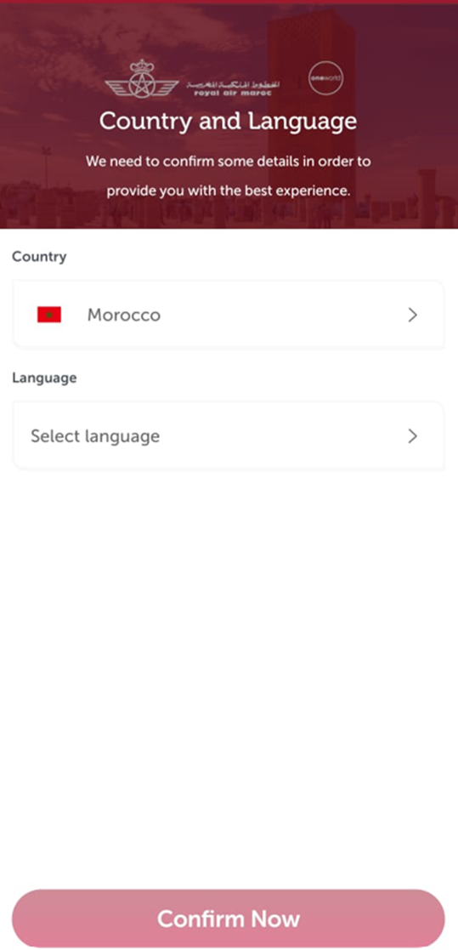
Competitive Analysis
Bright Welcome page.
Tutorial
Strong colors
Rigid interface
Text before visuals (almost none)!
Stabdard navigation bar
No offers
Not Bright welcome page
No tutorial
Vibrant and soft colors
Dynamic interface
Visuals before text
Custom navigation bar
Multiple offers

Slide 12
UX EVALUATION :Royal AIR MAROC APP
Usability
Learnability
Efficiency ,satisfaction
Accessibility
Visual design

Slide 13


User Psychology
Consider user psychology and adapt the app to their needs, considering factors like impatience and limited concentration. Make it intuitive; users won't waste time figuring out an app when there are quicker alternatives. Use contrasting colors for call-to-action buttons to make them stand out. Apply Heck's Law, minimizing user actions for faster decisions. In the QA tutorial, emphasize the most relevant options.

Slide 14
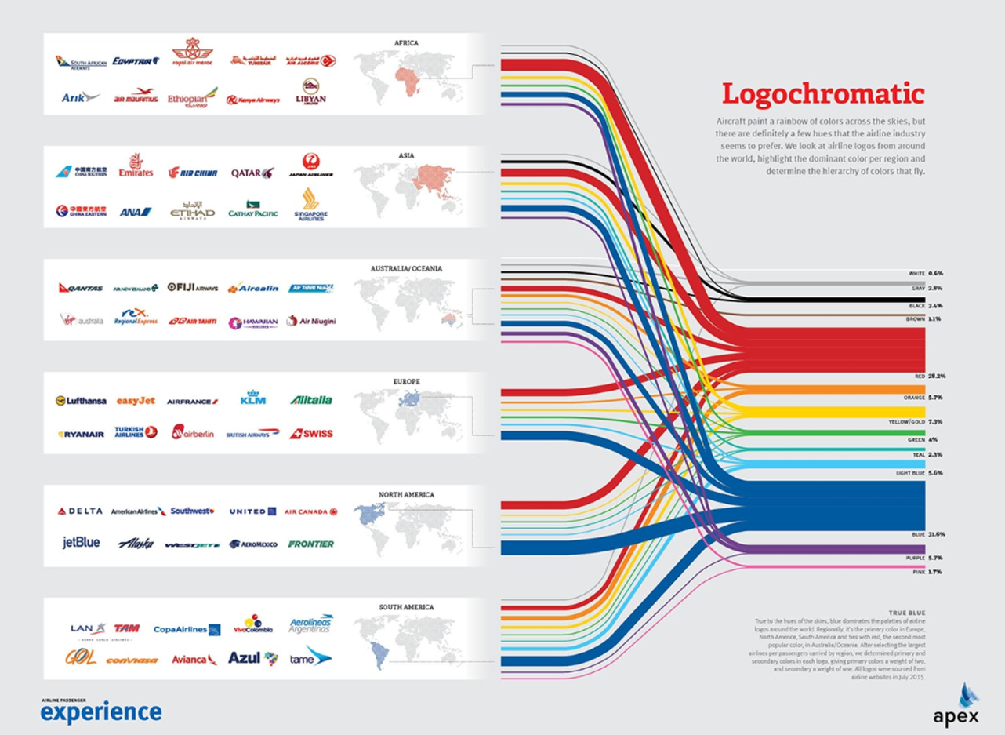
User Psychology

Slide 15
“Let’s Make it real”

Slide 16
Information Hierarchy
Welcome Page
Home Page
Menu Bar
Booking
Trips
Profile
Login
One Way
Transit
Return
Current Trip
Past Trips
Sign up
Flight Route
Location
Location
Date
Date
Payment Options
Time
Time

Slide 17
Enhancing the Moroccan Airline App: Information Architecture Focus
Information Architecture is the backbone of our project, vital for enhancing the Moroccan Airline app. It dictates how information is structured, labeled, and navigated, ensuring a user-friendly and satisfying experience. It optimizes navigation, reduces frustration, and enhances usability, aligning with our goals for an improved app experience.“
Our primary goals includes:
increasing user satisfaction
optimizing navigation
boosting the overall usability of the app
"Our team has been working on enhancing the Moroccan Airline's mobile app to improve the user experience.“

Slide 18

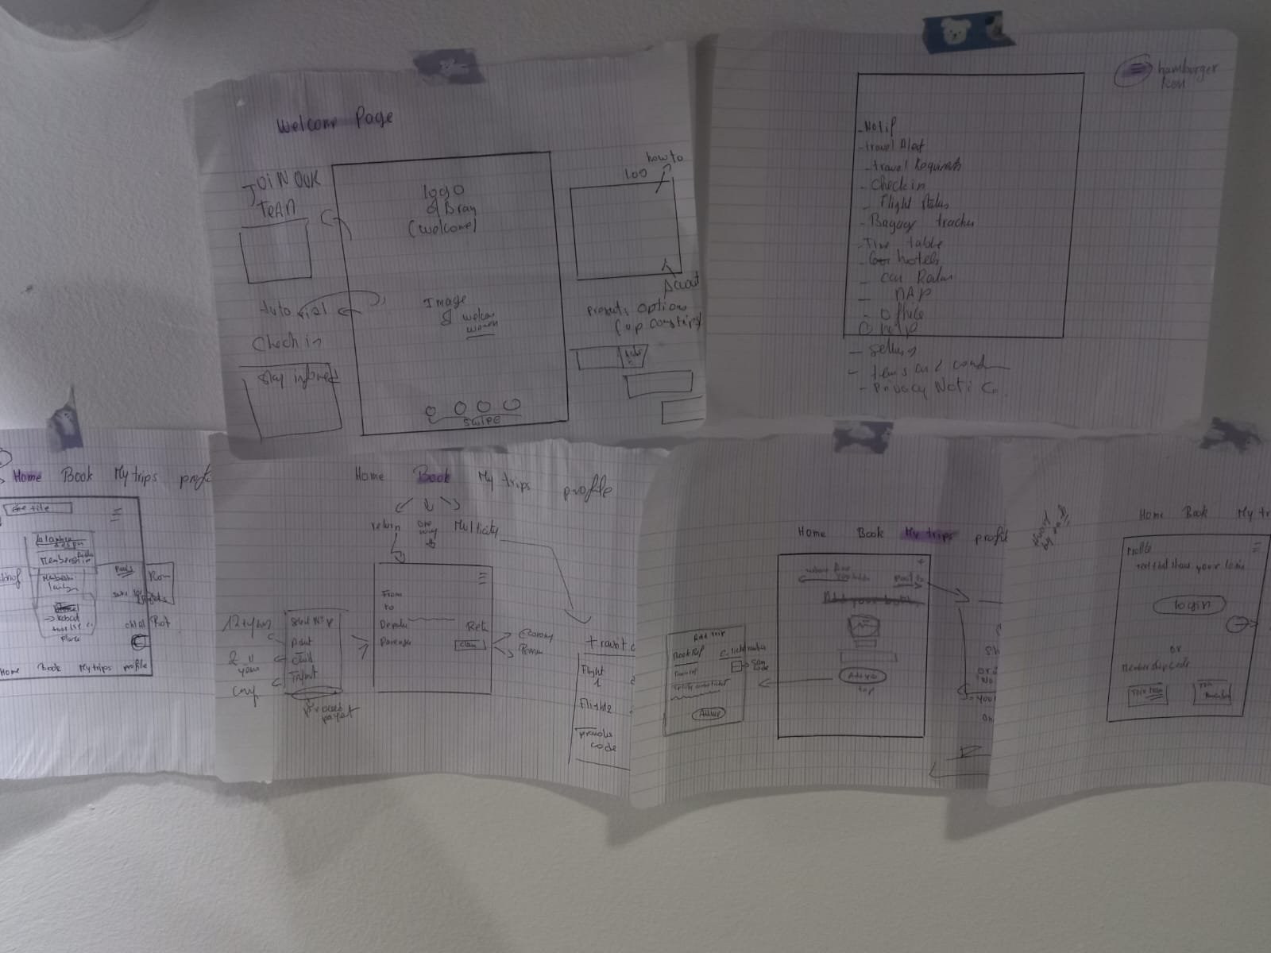
Sketching Phase:
In the initial phases of our design journey, we initiated the process with sketching to create a visual blueprint for the app. This blueprint was carefully crafted to cater to our diverse user base, ensuring simplicity and ease of use for every user, while also delivering an aesthetically pleasing experience for our business-oriented users."
“Sketching allowed us to explore layout ideas and begin planning navigation."

Slide 19
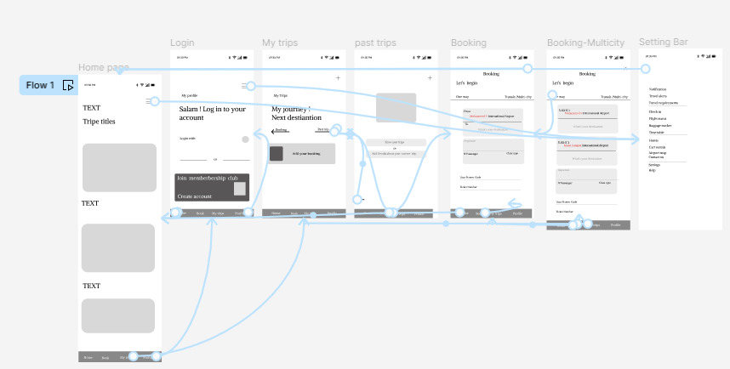
Prototype Development: Turning Ideas into Reality
The sketches evolved into a digital prototype, taking our ideas one step closer to reality.in this project we used a tool of figure to design our prototype .
Visual: Display key screens and wireframes of the app.

Slide 20
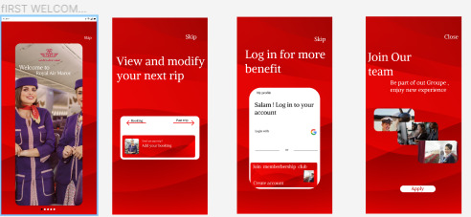
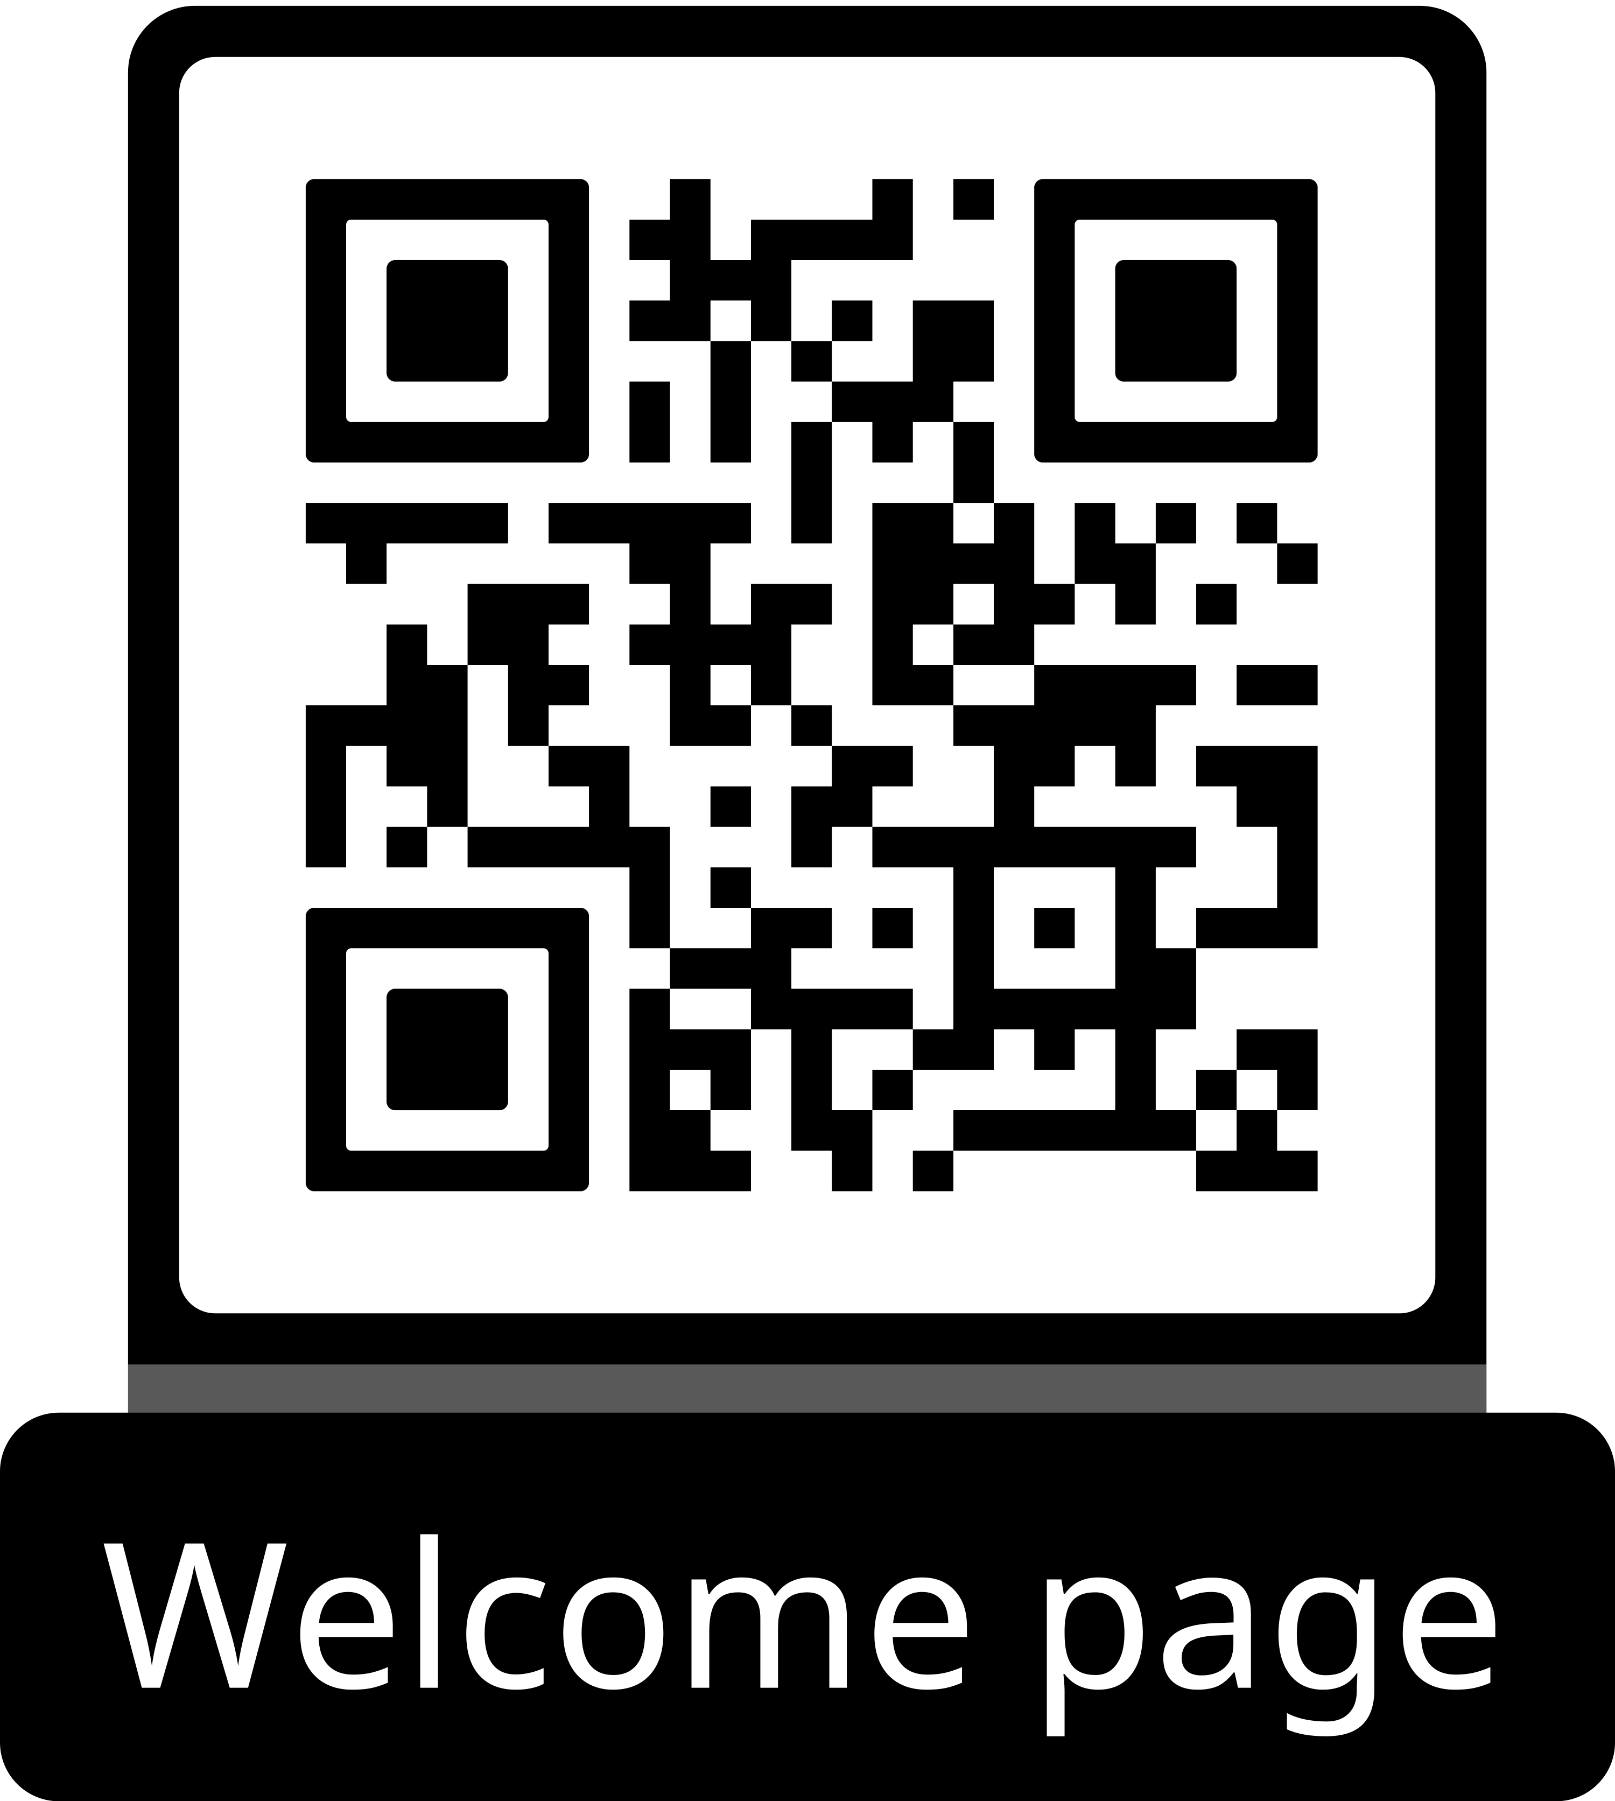
User-Centric Approach: Meeting User Needs Turning Ideas into Reality
Our approach is firmly rooted in thorough user research and valuable feedback, ensuring that we effectively address their specific needs. As a result, the prototype has been meticulously crafted to align with user expectations and alleviate pain points. In conclusion, our Information Architecture design is a key driver behind enhancing user satisfaction and boosting overall usability.

Slide 21
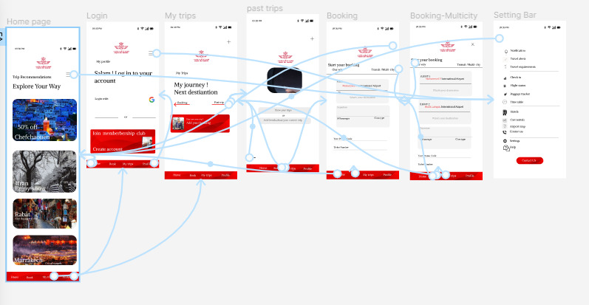
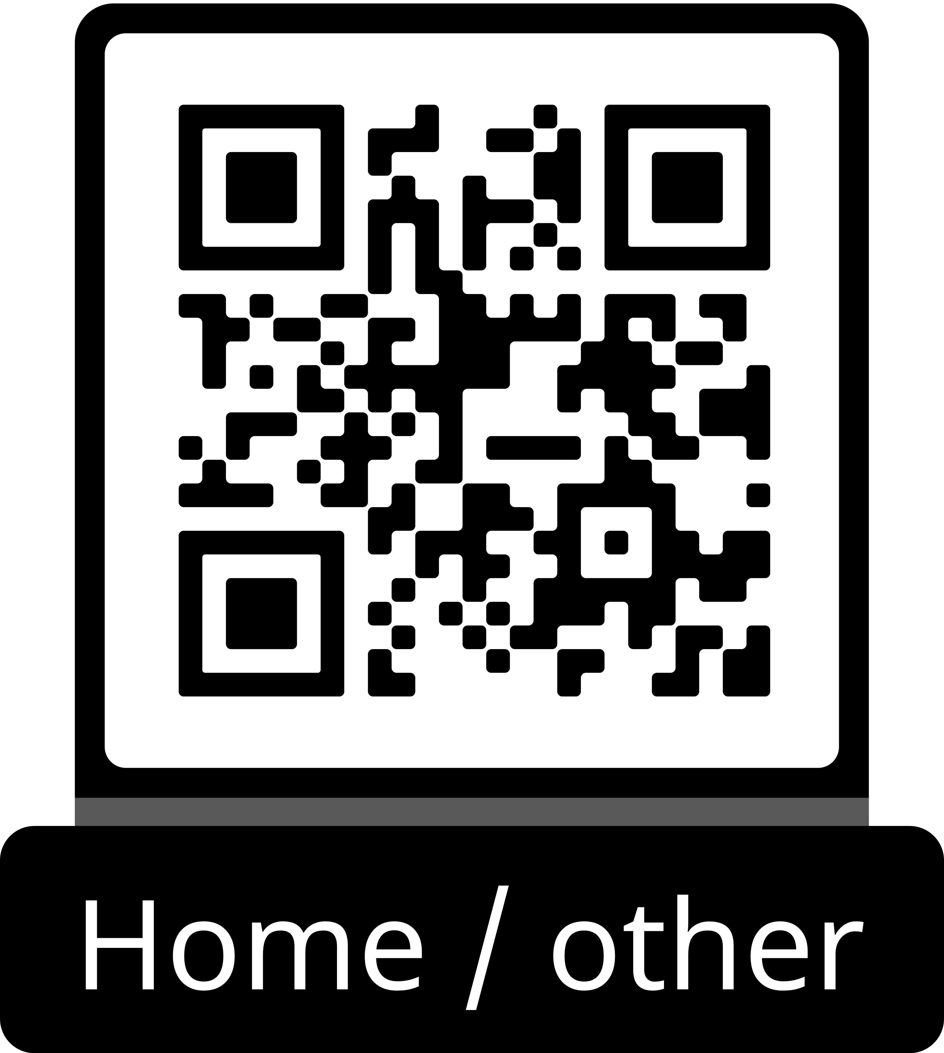
User-Centric Approach: Meeting User Needs Turning Ideas into Reality

Slide 22
Recommendations
Exploit color psychology
Adjust font size
Add visuals
Voice recognition
Add an advanced chatbot
Establish a points system for user benefits
Make offers catered to different communities
Survey for user-specific experience

Slide 23
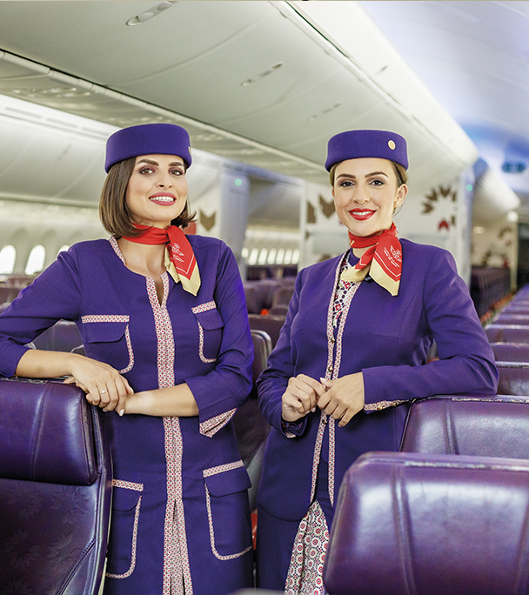
Thank you
Team members:
Lamiae Mansouri Idrissi
Nizar Gadari
Salma El Fillali

